Slide 1

Python for Beginners with applications Lesson 9: Introduction to Pandas library: Cleaning Data
Write code from scratch in a clear & concise way, with a complete basic course.
From beginners to intermediate.
Abdesselam Filali 2025-07-08 17h00 Algiers time

Slide 2

1. Data visualisation trick

Slide 3
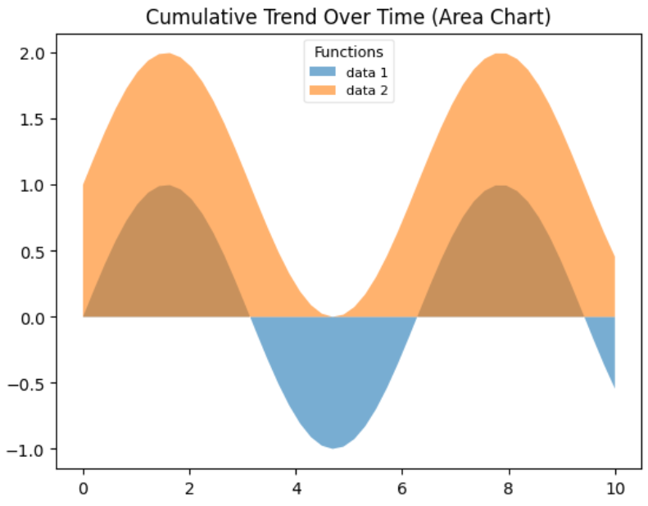


Visualization: fill_between & legend import matplotlib.pyplot as plt import numpy as np x = np.linspace(0, 10, 50) y1 = np.sin(x) y2 = np.sin(x) + 1 plt.fill_between(x, y1, alpha=0.6, label='data 1’) plt.fill_between(x, y2, alpha=0.6, label='data 2’) plt.title('Cumulative Trend Over Time (Area Chart)’) plt.legend(loc=1) plt.show()
Data Visualization
Legend

Slide 4
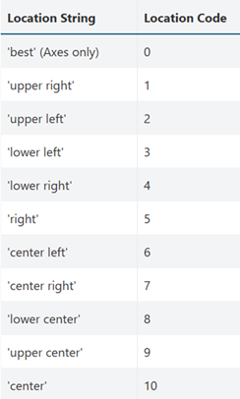
Visualization: fill_between & legend plt.legend( loc=, ncol=, fontsize=, framealpha=, title='Functions’, title_fontsize= )
Data Visualization
Legend : location

Slide 5
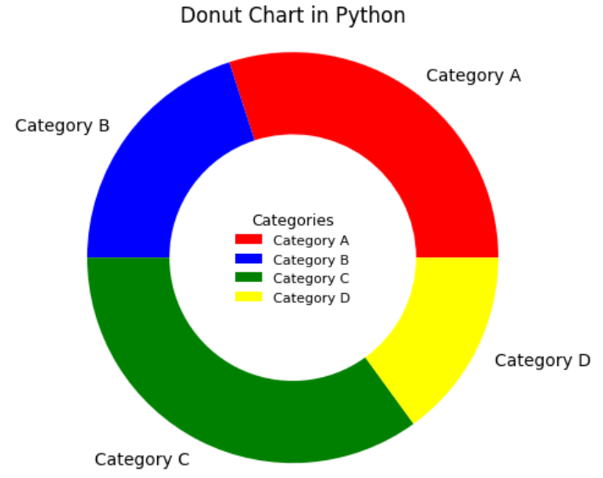
Visualization: fill_between & legend labels = ['Category A’, 'Category B’, 'Category C’, 'Category D'] sizes = [30, 20, 35, 15] colors = ['red', 'blue', 'green', 'yellow'] plt.pie(sizes, labels=labels, colors=colors, wedgeprops={'width': 0.4}) plt.axis('equal') plt.title('Donut Chart in Python') plt.legend(loc=10, fontsize=8, framealpha=0, title='Categories’, title_fontsize='9') plt.show()
Data Visualization
Legend donut chart

Slide 6
2. Introduction to Pandas library

Slide 7

What is Pandas? Built on top of the Python programming language. pandas is a fast, powerful, flexible and easy to use open source data analysis and manipulation tool, it is used for working with data sets. It has functions for analyzing, cleaning, exploring, and manipulating data. The name "Pandas" has a reference to both "Panel Data", and "Python Data Analysis" and was created by Wes McKinney in 2008. Pandas allows us to analyze big data and make conclusions based on statistical theories. Pandas can clean messy data sets and make them readable and relevant. Relevant data is very important in data science.
Pandas Library
Overview 1/2
https://pandas.pydata.org/
https://www.w3schools.com/python/pandas/default.asp

Slide 8
What Can Pandas Do? Pandas gives you answers about the data. Like: Is there a correlation between two or more columns? What is average value? Max value? Min value? Pandas are also able to delete rows that are not relevant, or contains wrong values, like empty or NULL values. This is called cleaning the data. Where is the Pandas Codebase? The source code for Pandas is located at this github repository https://github.com/pandas-dev/pandas
Pandas Library
Overview 2/2
https://pandas.pydata.org/

Slide 9
installation pip install pandas importing import pandas as pd Checking Pandas Version import pandas as pd print(pd.__version__) Loading a data file import pandas as pd df = pd.read_csv('data.csv’) print(df.to_string())
Pandas Library
Installation & importing
https://pandas.pydata.org/

Slide 10
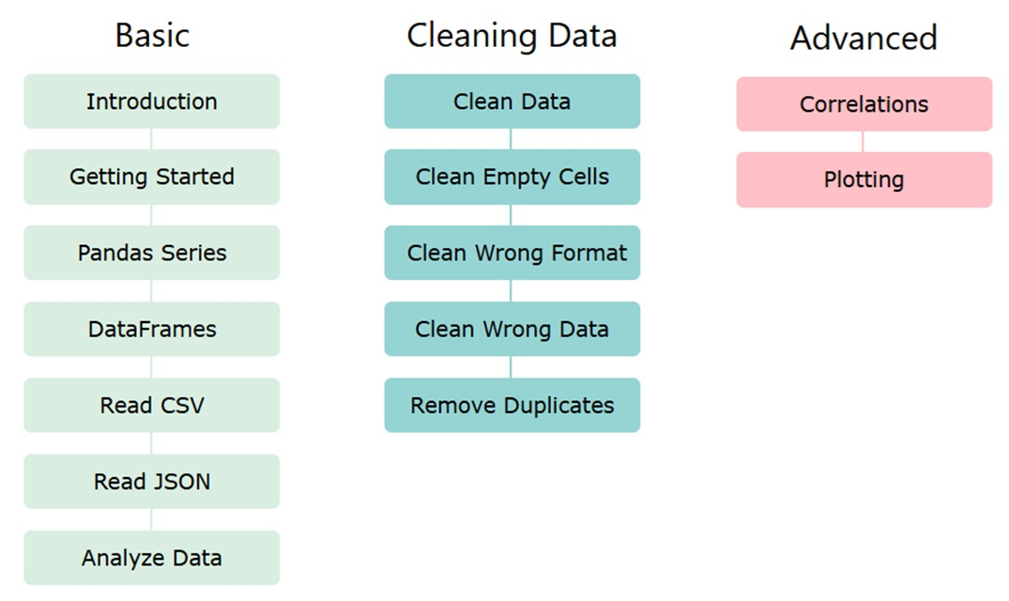
Pandas Library
Pandas Roadmap
https://pandas.pydata.org/

Slide 11
installation pip install pandas importing import pandas as pd Checking Pandas Version import pandas as pd print(pd.__version__) Loading a data file import pandas as pd df = pd.read_csv('data.csv’) print(df.to_string())
Pandas Library
Introduction
https://pandas.pydata.org/

Slide 12
Pandas Library
Pandas Series
What is a Series?
What is a Series?
A Pandas Series is like a column in a table.
It is a one-dimensional array holding data of any type. Example: import pandas as pd
a = [1, 7, 2]
myvar = pd.Series(a)
print(myvar)
https://pandas.pydata.org/

Slide 13
Pandas Library
Pandas Series
Labels ?
If nothing else is specified, the values are labeled with their index number. First value has index 0, second value has index 1 etc.
This label can be used to access a specified value. ype. Example: print(myvar[0])
Create labels ?
With the index argument, you can name your own labels.
Example: import pandas as pd
a = [1, 7, 2]
myvar = pd.Series(a, index = ["x", "y", "z"])
print(myvar)
https://www.w3schools.com/python/pandas/default.asp
https://pandas.pydata.org/

Slide 14
Pandas Library
Pandas Series
Labels ?
Key/Value Objects as Series
You can also use a key/value object, like a dictionary, when creating a Series.
Example: import pandas as pd
calories = {"day1": 420, "day2": 380, "day3": 390}
myvar = pd.Series(calories)
print(myvar)
Note :
The keys of the dictionary become the labels.
https://pandas.pydata.org/

Slide 15
Pandas Library
Pandas DataFrames
Definition ?
Data sets in Pandas are usually multi-dimensional tables, called DataFrames.
Series is like a column, a DataFrame is the whole table.
Example: import pandas as pd
data = {
"calories": [420, 380, 390],
"duration": [50, 40, 45]
}
myvar = pd.DataFrame(data)
print(myvar)
https://pandas.pydata.org/

Slide 16
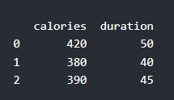
Pandas Library
Pandas DataFrames
Definition ?
Data sets in Pandas are usually multi-dimensional tables, called DataFrames.
Series is like a column, a DataFrame is the whole table.
A Pandas DataFrame is a 2 dimensional data structure, like a 2 dimensional array, or a table with rows and columns.
Example: import pandas as pd
data = {
"calories": [420, 380, 390],
"duration": [50, 40, 45]
}
df = pd.DataFrame(data)
print(df)
https://pandas.pydata.org/

Slide 17
Pandas Library
Pandas Read CSV files
Read CSV Files
A simple way to store big data sets is to use CSV files (comma separated files).
CSV files contains plain text and is a well know format that can be read by everyone including Pandas.
Example: import pandas as pd
df = pd.read_csv('data.csv’)
print(df.to_string())
https://pandas.pydata.org/

Slide 18
Pandas Library
Pandas Read JSON files
Read CSV Files
Big data sets are often stored, or extracted as JSON.
JSON is plain text, but has the format of an object, and is well known in the world of programming, including Pandas.
Example: import pandas as pd
df = pd.read_json('data.json’)
print(df.to_string())
https://pandas.pydata.org/

Slide 19
Pandas Library
Pandas Analyzing Data
Viewing the data:
One of the most used method for getting a quick overview of the DataFrame, is the head() method.
The head() method returns the headers and a specified number of rows, starting from the top.
Example: import pandas as pd
df = pd.read_csv('data.csv’) print(df.head(10))
https://pandas.pydata.org/

